Slide 1
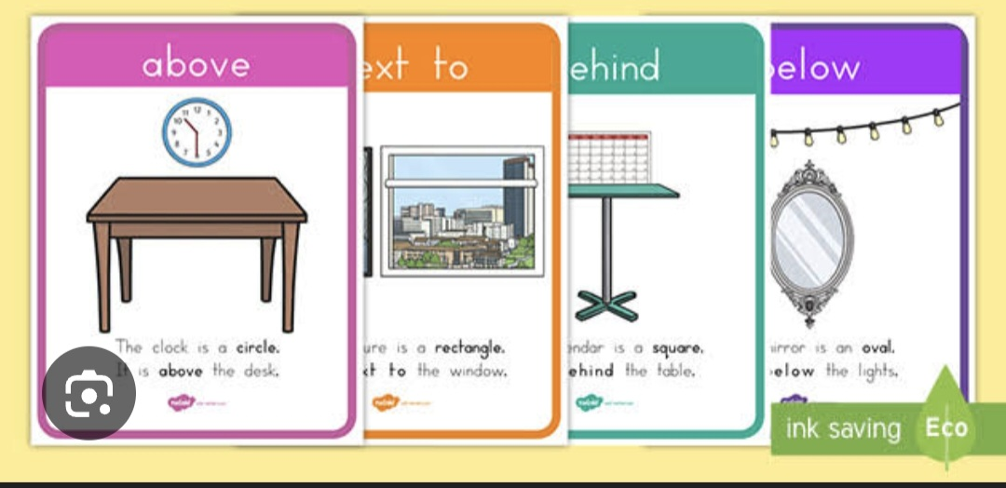
Views and positions

Slide 2
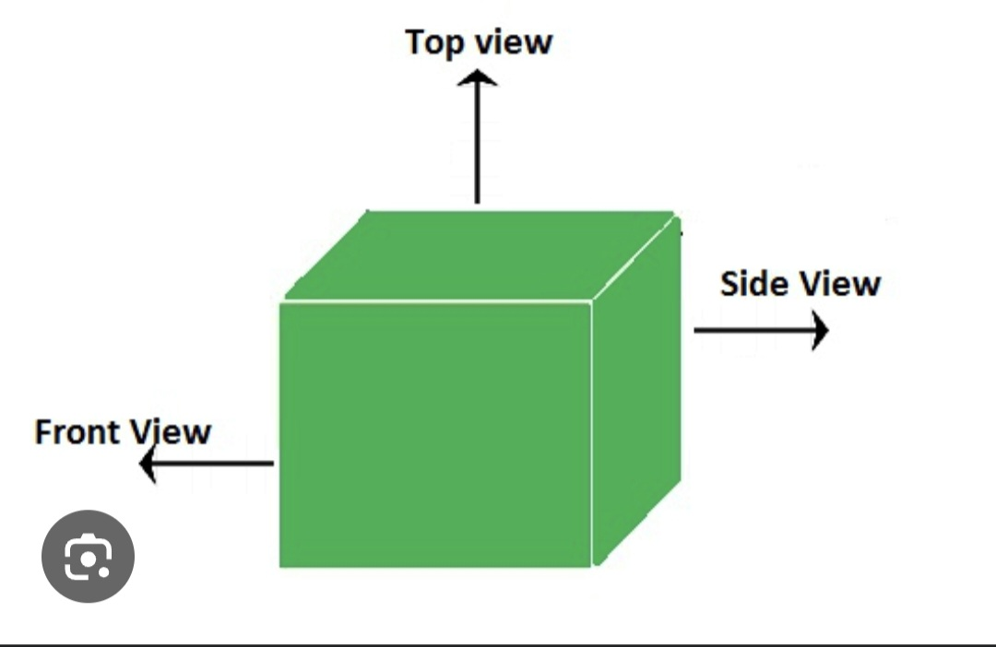
Three dimensional/3d shapes are solids that have 3 dimensions such as length width and height.

Slide 3
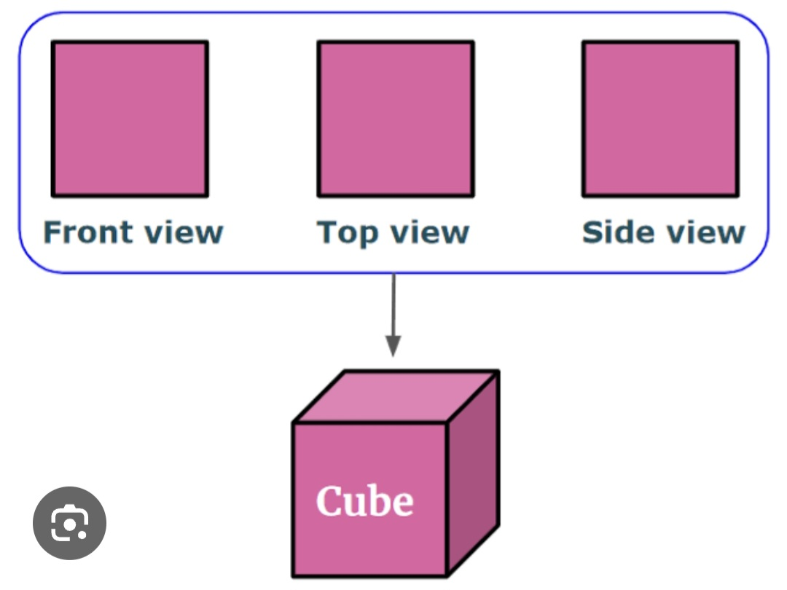
Three Dimensional views of a cube

Slide 4
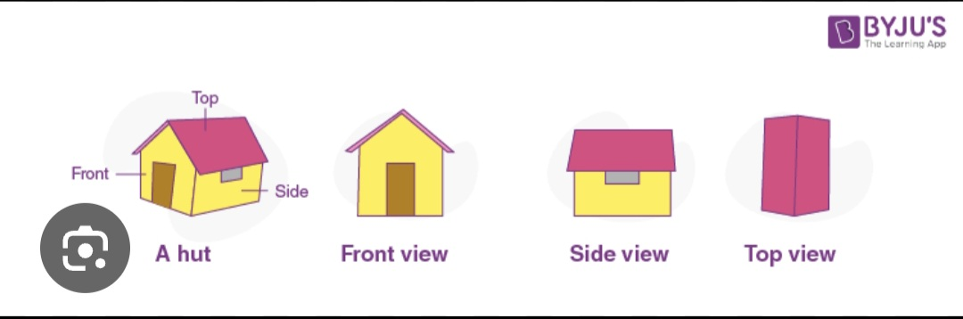
Three dimensional looks of a hut

Slide 5
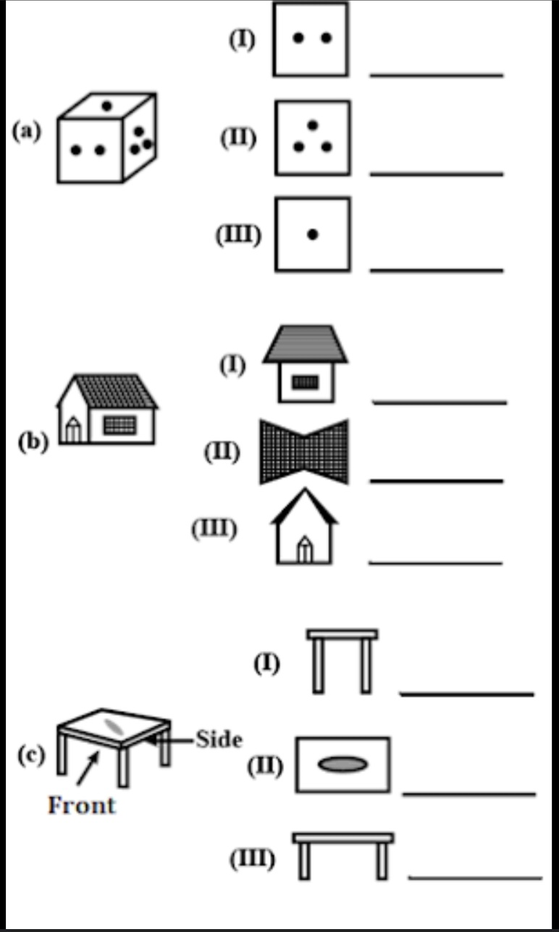
Activity

Slide 6
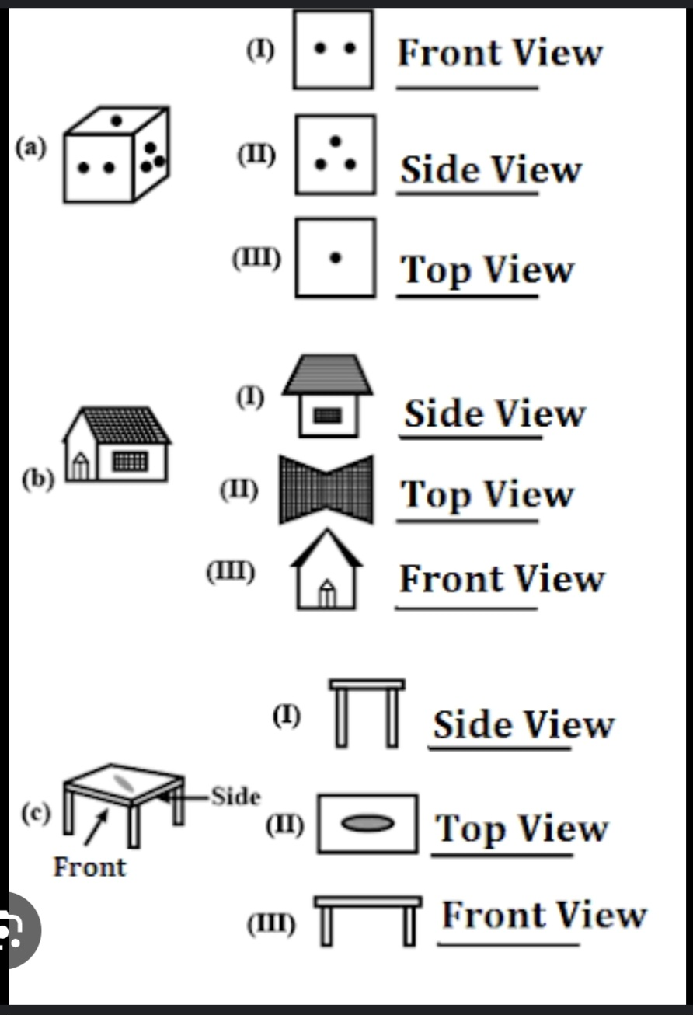
Memo

Slide 7
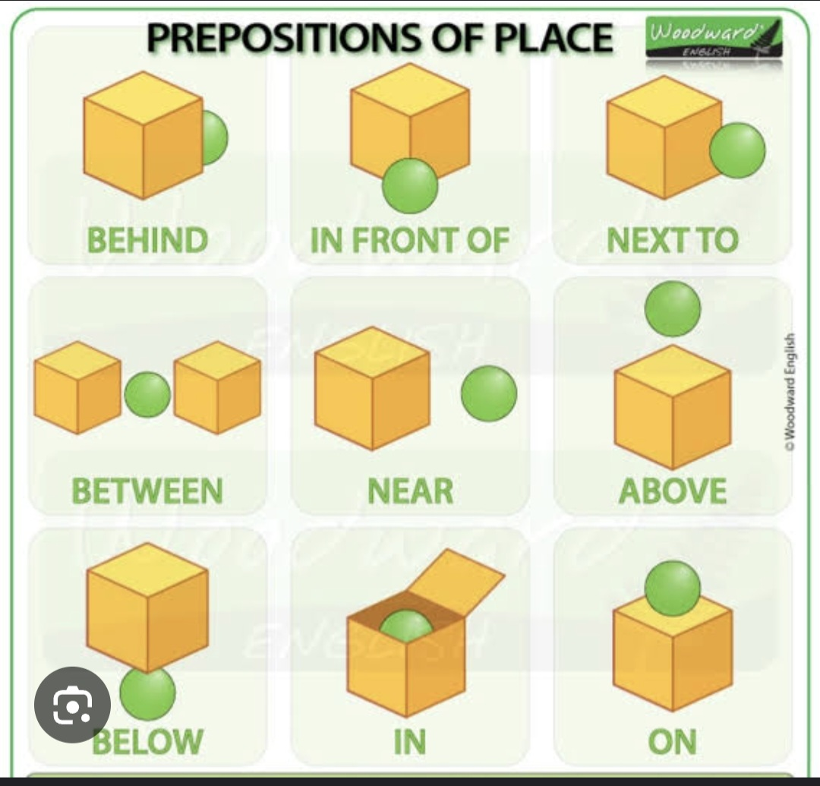
Preposition of place it Describes where something is in relation to another

Slide 8
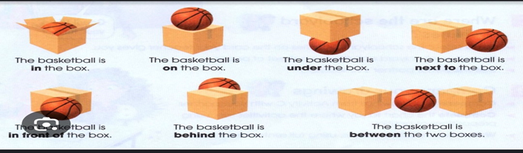
The position of the basketball to the box

Slide 9
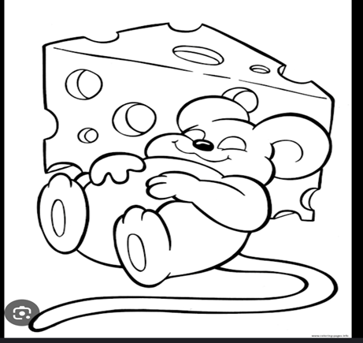
1. What position is the mouse is to the cheese ?

Slide 10
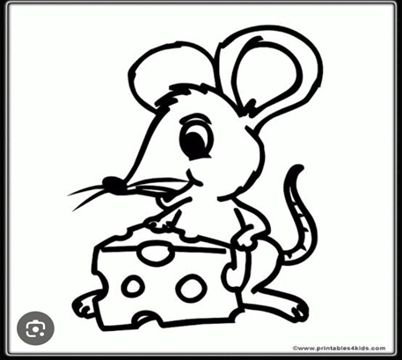
2. What position is the mouse to the cheese ?

Slide 11
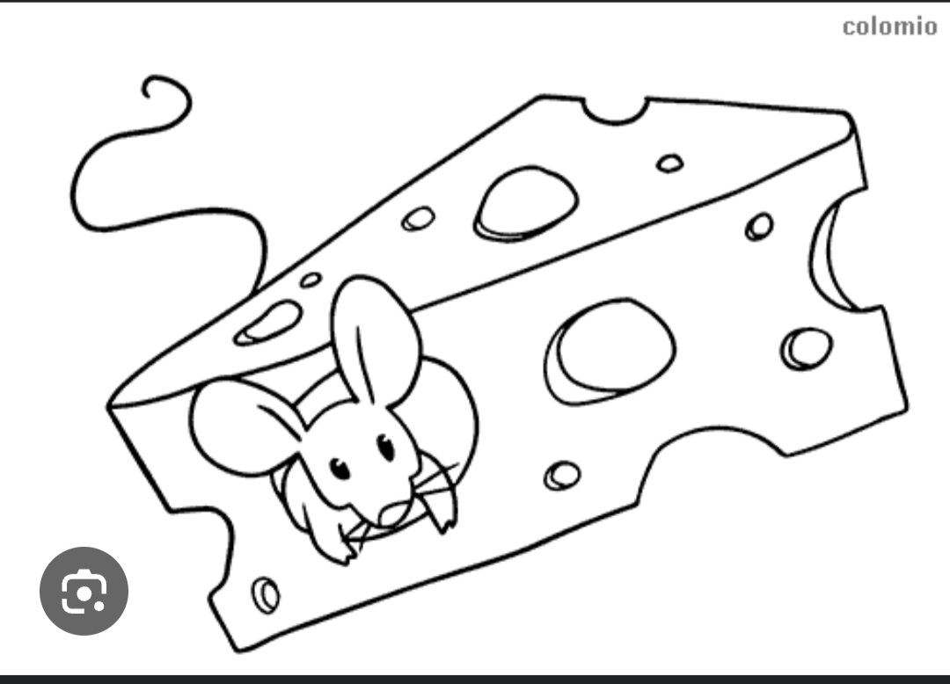
3. What position is the mouse to the cheese ?

Slide 12
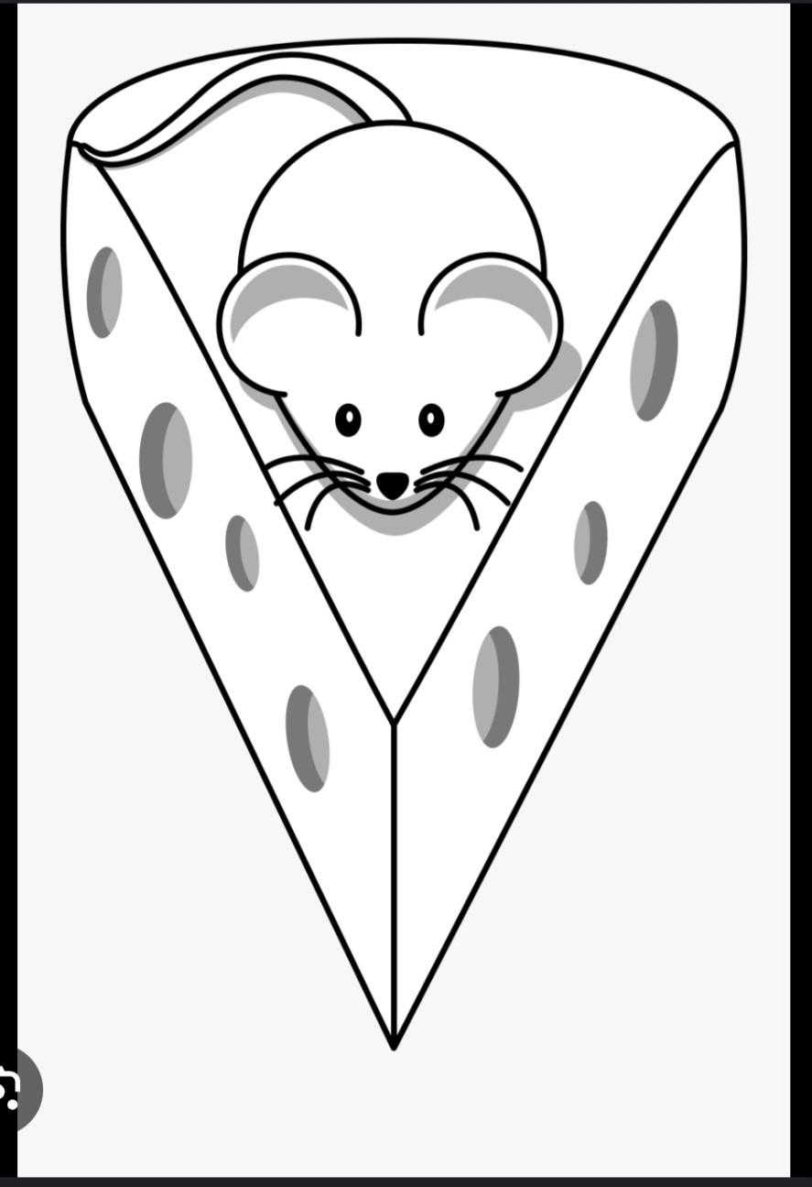
4. What position is the mouse to the cheese ?

Slide 13
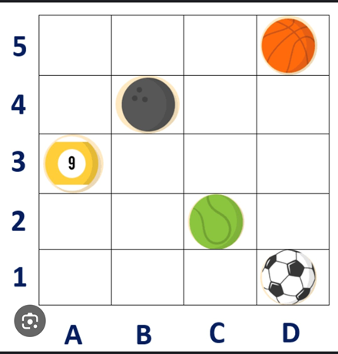
Use the coordinates to locate the position of the following balls. Basketball, Tennis ball, soccer ball, pool ball and bowling ball.

Slide 14
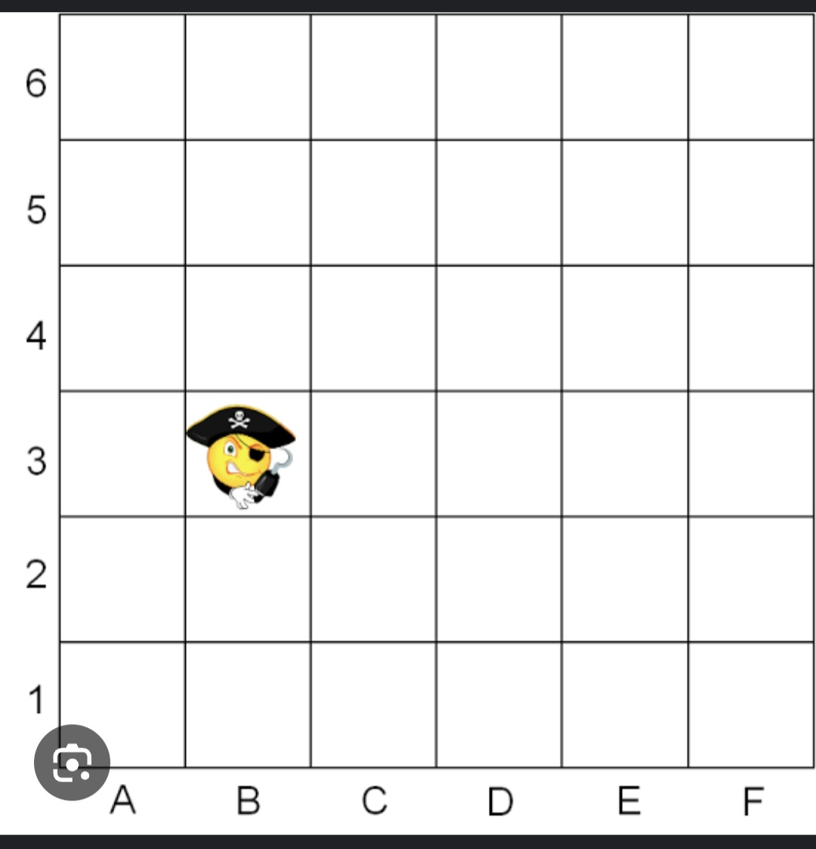
Use the coordinates to locate the position of a pirate

Slide 15
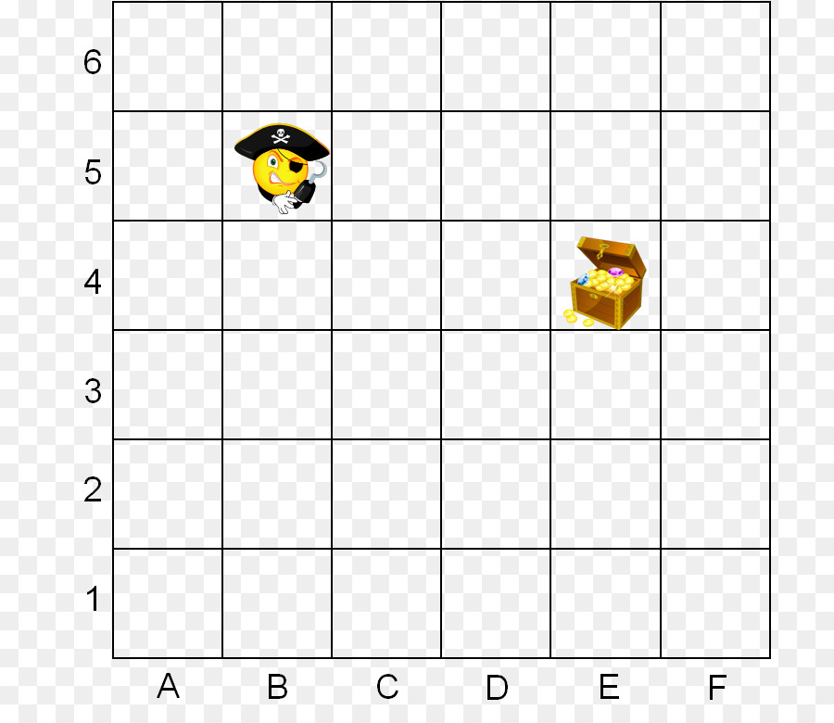
What are the coordinates of the position of the treasure?

Slide 16
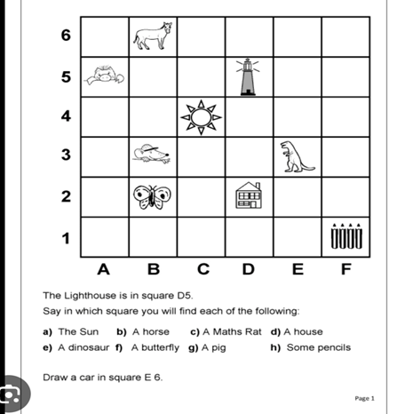
Activity

